Slide 1
Vitamin D: a growing problem
Dr James Bunn
Alder Hey Children’s Hospital NHS FT
No commercial interests
No conflicts of interest

Slide 2
Vitamin D
Deficiency causes problems in:
  Bone growth
    Rickets and musculoskeletal pain
    craniotabes
  Muscle functioning
    Myopathy/ cardiomyopathy
  Calcium and phosphate regulation
    Hypocalcaemic convulsions in infants
  Susceptibility to Infection
    Increased risk of TB, and response to Rx

Slide 3
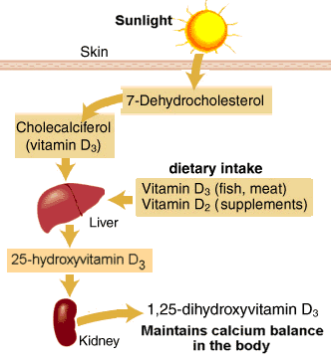
Metabolism of vitamin D

Slide 4
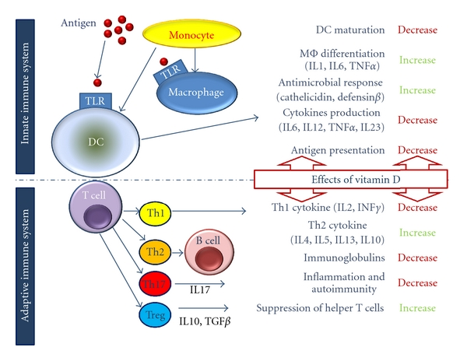
Potential Immunologic effects

Slide 5
8 interesting facts
90% of vit D comes from sunshine
Seasonal pattern for deficiency
Pigmented skin needs up to 6x more sun
Factor 15+ sunscreen blocks >99% of sun
Breast milk has limited vit D (25 IU/litre)
Maternal vitamin D a good source for baby
Fortification is only in some foods
BME diets may not utilise fortified foods

Slide 6
A growing problem
Increase in the level set for sufficiency
Surveys suggest highly prevalent
  In Somali community 82% deficient
Associated conditions increasing
  Chronic diseases and Obesity
Increasingly recognised
  High profile cases
  Advocacy
  Increased testing

Slide 7
Clinical cases
3 month old, 5th child
Afro-Carribean parents
Breastfed
5 minute convulsion,
  calcium 1.8mmol/l, PTH 48.1
  Reduced bone density
Family history
  hypocalcaemic convulsion in 12 y old sibling
  Mother vitamin D deficient, no pregnancy vit D

Slide 8
Cardiomyopathy
16 cases at Great Ormond Street
Presenting with heart failure
Infants, first year of life
12 were exclusively breastfed

Slide 9
Case study
4 year old with aches and pains
Some splaying of wrists
  X ray changes of rickets
Vitamin D deficient 15nmol/l
Rx cholecalciferol 200,000 units total dose
  Choice of 6,000 units daily for 1 month
  Or 20,000 units for 10 doses
Check symptomatic response, and bottle
Repeat blood biochemistry
Consider family members vit D risk

Slide 10
Case study
10 year old Caucasian child referred by GP
Insufficient vit D3 (37pmol/l), vit D2 <4
Blood tested as abdominal pain
Asymptomatic
Vit D probably not cause of symptoms
Supplement 400 IU/ day for winter months

Slide 11
Co- morbidity
Renal disease
Gut malabsorption
Cystic fibrosis
Neuromuscular disease
Drug interaction e.g. Anticonvulsants
(Obesity)
Pathways now suggesting yearly testing

Slide 12
At risk groups
BME
Cultural
  covered skin (in mother or child)
  Reduced use of fortified foods
Sunblocks and conflicting messages
Breastfeeding

Slide 13
Guidance on prevention
COMA 2003
NICE (in low income households) 2008
CMO 2012
RCPCH 2012
All indicate children <4-5 years should be supplemented when not on formula milk, and all mothers supplemented in pregnancy
But only NICE is a required provision for CCGs and Trusts
Healthy Start vitamins are the available intervention
  Uptake Nationally is low, and process complex

Slide 14
Choices in Management
  Adequate fortification for population
  Advise high vitamin D containing foods
  Supplement all
  Supplement those on low incomes
  Supplement high risk groups
  Test high risk groups and treat
  Test only when symptomatic, and treat
  Await morbidity (and occasional mortality)

Slide 15
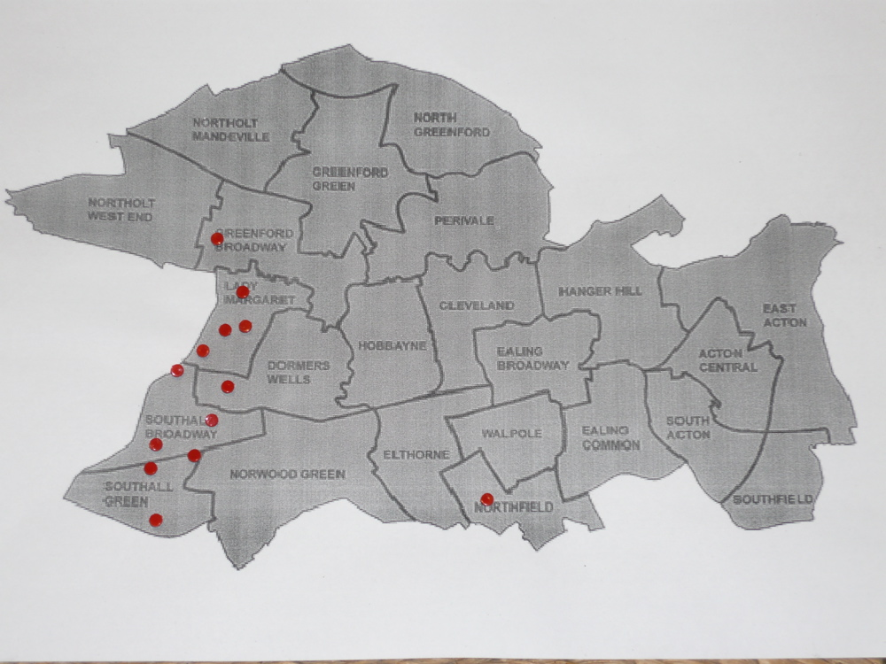
Who gets tested?
Ealing infant hypocalcaemia cases

Slide 16
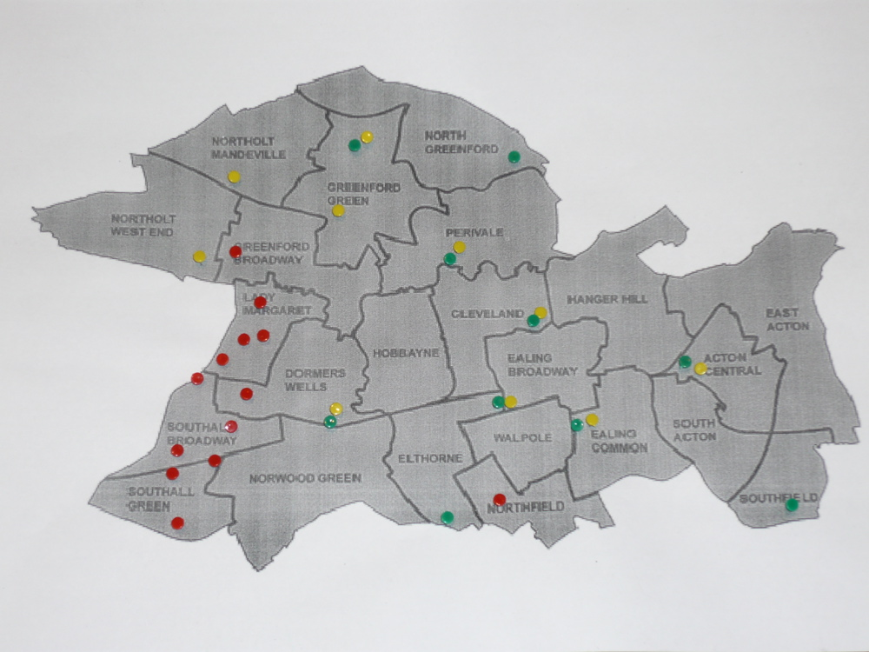
GP vit D tests (yellow) and top 10 vit D prescribing practices (green) in Ealing
Credit to Colin Mitchie
Ealing Hospital for maps

Slide 17
Experience at Alder Hey

Slide 18
Seasonality of deficiency

Slide 19
Proportion deficient unchanged

Slide 20
Increase in deficiency in those first tested

Slide 21
Deficiency in older children:
? related to testing protocols

Slide 22
Which specialty is testing?

Slide 23

General practice is more aware and testing kids more

Slide 24
Challenges
What products are available
Multivitamins recommended as supplement
Vitamin D products +/- calcium
Cholecalciferol (vit D3) recommended as Rx
Ergocalciferol (Vit D2)
alfacalcidol (one alpha) only in renal disease

Slide 25
Drug or food supplement?
Quality assurance of vit D
Does not require same level of QA as drugs
QA testing of possible Rx
  17% active ingredient in one liquid
  Variable in capsules (~25%)
Specials very expensive
  Up to £500 from community pharmacies
  Moderately cheaper from hospitals
? QA for Healthy Start

Slide 26
Challenges
NICE only for low income
Healthy Start very low uptake
  Targeted v.s. Cost recovery vs Universal
Conflict with Breastfeeding messages
Conflict with skin cancer avoidance message
Potential for Commercial interest
  Vit D supplemented ‘more healthy’ products

Slide 27
Some practical points
If not symptomatic - supplement, don’t test
Supplement family members of cases
  Under 5, growth spurt, pre pregnant, pregnant
Ensure supplementation in all pregnancies
Check if iron deficient as well
Top up vitamin D each winter in deficiency
Public health approaches cheaper than test and treat approaches

Slide 28
Cautions on measuring vitamin D supplementation programme success
Increased recognition of symptoms
Increase in testing, so may identify more
Increasing numbers on treatment.
Case reporting not helpful (eg BPSU)
  Poor definition of common morbidity
  Hypocalcaemic convulsions rare
A need for true population surveys
Measure coverage of intervention

Slide 29
Vitamin D: a growing problem
Better recognition of symptoms
Risk groups and obesity increasing
Recognition of non bony morbidity
Increased testing
  ? Appropriately directed
Increasing scientific publication
Increasing public interest
Commercial opportunism

Slide 30

Thank you

