Slide 1
Vitamin D Deficiency in Liverpool where are we now?
Dr Katy Gardner (Clinical lead Liverpool Vitamin D group)

Slide 2

Northern latitude.... North of London

Slide 3
Symptoms of deficiency: (adults)
Bone Pain,
Muscle Weakness,
Waddling gait
OSTEOMALACIA
Lethargy/ tiredness
Falls/ fractures in older people

Slide 4
Symptoms of deficiency: (children)
Babies: irritability, convulsions.
Rickets…delayed closure of fontanelles, bow legs/knock knees, bone pain, poor growth, delayed walking, swollen wrist joints
Lethargy in children...NB may be also associated with anaemia ………..

Slide 5
Who is at risk...could it be you?
Skin colour: darker
Low exposure to sunlight
Diet low in Vitamin D
Medical conditions: Coeliac , Crohn’s
Older people: esp. if mostly indoors
Pregnancy and breastfeeding
Obesity BMI >30
(Diagnosis and management of vitamin D deficiency : Pearce S, Cheetham T. BMJ 2010;340:b5664)

Slide 6
How did it begin? Liverpool Somali study 2004
In 2003 GPs picked up deficiency/ osteomalacia in Somali patients
Study: 292 Somalis in L’pool all ages >age 2
Found 82% deficient
Community supplement study: low uptake:- unpleasantness of Calcium was a main factor

Slide 7
Liverpool Somali study 2004

Slide 8
Dietary study Somali community
Health promotion messages did not correspond to people’s diet
Somalis ate little food containing Vitamin D
75% had someone in family suffering from bone and muscle pain
(Maxwell S, Salah S, Bunn J. (2006)
Journal of Human Nutrition and Dietetics, 19 (2), p.125-7.)

Slide 9
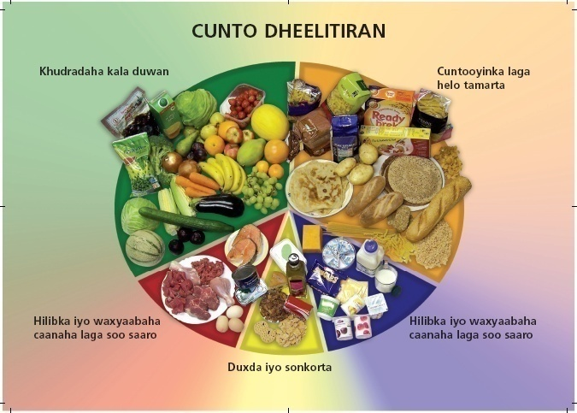
Somali Food plate: example of dietary adaptation by Samsam Salah and Shirley Judd (PCT)

Slide 10
Rickets in Merseyside
2010: Mother not identified when pregnant, or breast feeding, ….child not identified till symptoms
2011: 2 cases in my practice of 4000 patients
One child: Rickets =family at risk

Slide 11
Audit of local practices 2008
Neighbouring practices very different knowledge and testing rates
Guidelines distributed
Re audit: increased numbers diagnosed! Education works!

Slide 12
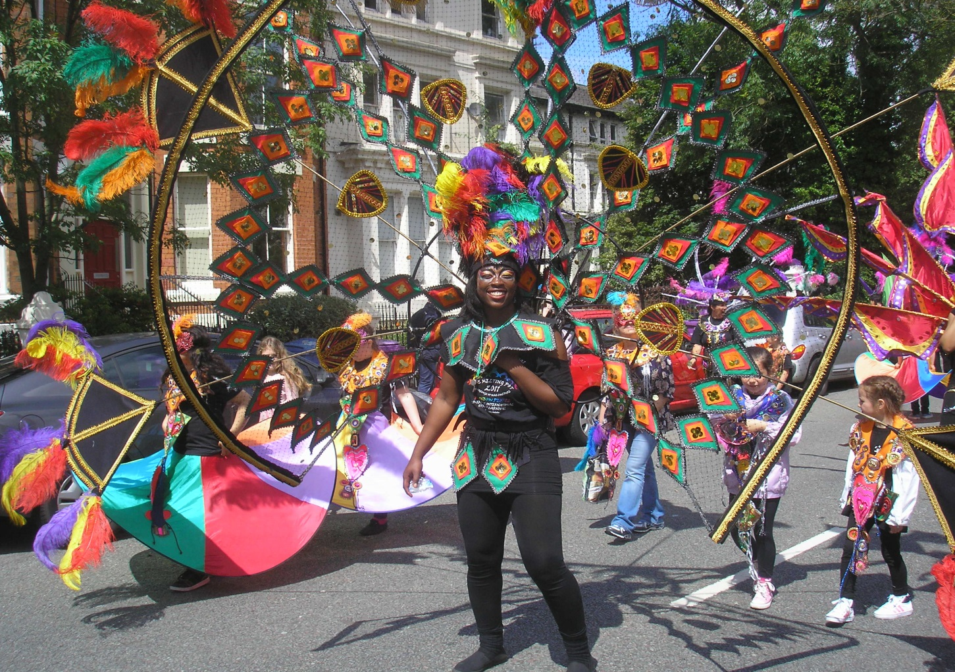
Community education.......

Slide 13
What did we do next ?
Developed guidelines: Test people at risk AND with symptoms. Treat if deficient
Prevention: DOH, NICE ensure uptake of Healthy Start
and ......beyond… but PCT said No
Educate: health professionals and public

Slide 14
2012: North Mersey Guidelines and local leaflet
http://www.northmerseyammc.nhs.uk
or Map of Medicine
or
katy.gardner@livgp.nhs.uk

Slide 15
Vitamin D Testing in Liverpool 2007-2012 (Dr Steven Zhao et al 2013)

Slide 16
Who are we testing?

Slide 17
What are results?

Slide 18
So………..
More testing after BMJ article (2011), GP Update Course and local guidelines
More deficient in absolute numbers
BUT proportionally more sufficient! I.e. less targeted testing………..
Testing all through the year but more deficient results in winter…………….

Slide 19
Testing and treatment is expensive! So we need …..
Fully implement prevention for pregnant and post natal women
GPs should think about who and when to test and follow local guidelines
NICE guidelines/prevention strategy for England and Wales (all ages and ethnic groups)

Slide 20
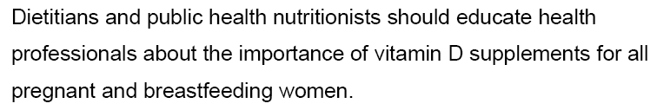
Prevention guidelines
NICE: Maternal and child nutrition 2009
“People at risk of low sun exposure should take 10mcg/400units Vit D daily” (consensus statement 2010)

Slide 21
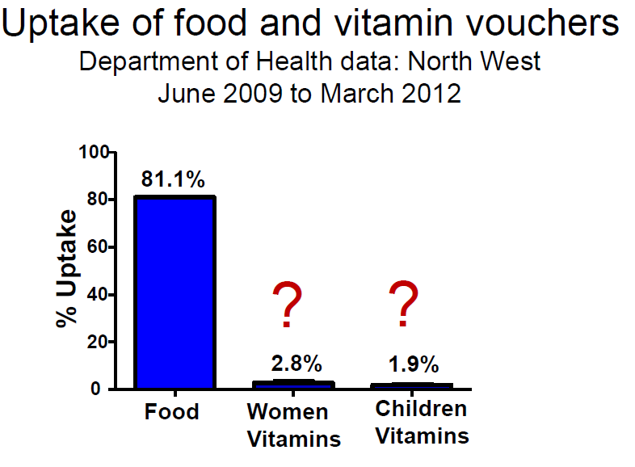
Healthy Start : Study of local targeted/universal areas by Dr May Moonan L’pool Uni 2012

Slide 22
Targeted: mothers - barriers
Not at any point in the maternity hospital or the GP practice did anyone tell me I was entitled to Healthy Start
I noticed the vitamin voucher at the top of the letter but it did not say where you could get them from
The lady said to phone this number ‘cause I had to update the Healthy Start people to get my vouchers

Slide 23
Universal: mothers
My GP, and then the health visitor and midwife kept checking that I was getting them
I did not mind having them as I knew everyone else was getting them
The Red book was a useful reminder

Slide 24
Professionals:
Targeted: I felt uncomfortable asking women about financial circumstances
I never received any specific training about the Healthy Start scheme
Universal: It works well because no matter whether you are eligible for Healthy Start you can get them

Slide 25
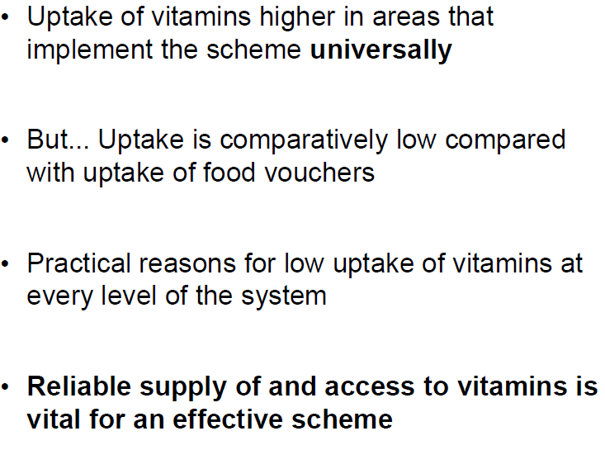
She concluded…………..

Slide 26
October 2013 Universal roll out: CCG said yes!
Working with Public Health/City Council: everyone on board
Via Women's hospital (CQUIN) and Children's Centres
Health visitors and midwives vital (see previous report)
BUT reorganisation of NHS! Disruption of Healthy Start ……….

Slide 27
Many questions remain e.g....
What is the optimal Vit D level?
Does it affect pregnancy outcomes? Can higher levels reduce risk of cancer/ chronic diseases?
How much sun exposure needed to optimise levels in different skin types?
What is the role of diet/supplements?

Slide 28
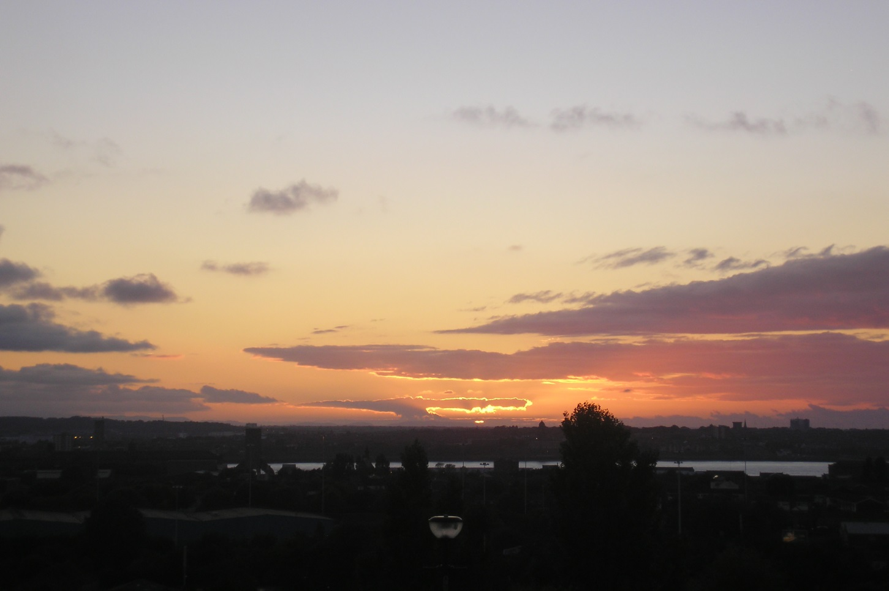
“Vitamin D deficiency: the time to ignore it has passed.”
Int J Rheum Dis. 2010 Oct;13(4):318-23. doi: 10.1111/j.1756-185X.2010.01559.x

