Slide 1
Vitamin D: pregnancy, breastfeeding, babyhood
Magda Sachs
Public Health , Salford

Slide 2
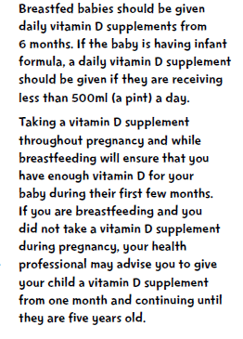
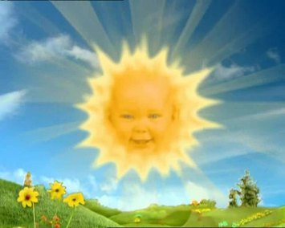
UK Recommendation to parents

Slide 3
recommendations
Country | Pregnant Women | Babies
UK | 400 IU (10mcg) | 6-12 months 300 IU (7.5 mcg)
USA | 600 IU (15 mcg) | 0-12 months 400 IU (10mcg)
Canada | 600 IU (15mcg) | 0-12 months 400 IU (10 mcg)

Slide 4
What do you hear?

Slide 5
I thought breastmilk had all the nutrients a baby needs
If our milk is ideal, “perfect,” even, why recommend a supplement? Is this another booby trap to make us think our own milk is inadequate?

Slide 6
We have been working with people on healthy diet, now you’re saying we should tell them to supplement?
I think unnecessary supplementation can do more harm than good.

Slide 7
I keep reading about needing to have Vitamin D, but my Midwife & GP only mentioned Folic acid.
I read somewhere that they should have vitamin D, and asked my HV but she didn't know anything about it. I don't currently give him anything but maybe I should?

Slide 8
Concern that recommending Vitamin D will
  undermine confidence in adequacy of breast milk / breastfeeding
  undermine confidence in the importance of a balanced diet

Slide 9
Vitamin D deficiency
is sunlight deficiency

Slide 10

Vitamin D
Is synthesised by a hormone reaction from UV radiation on skin
We are not designed to obtain our requirements through diet, so vitamin D is not passed through milk in any substantial quantity
Our lifestyle is deficient in sunlight

Slide 11

Why do we struggle to get enough Vitamin D?
Remain indoors
Cover up – including with sun cream
Dark skin – increased risk
Pollution
British weather

Slide 12
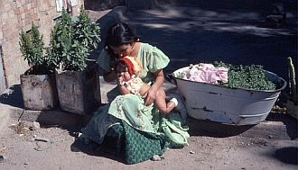
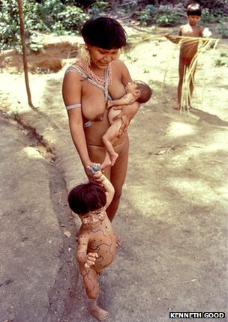
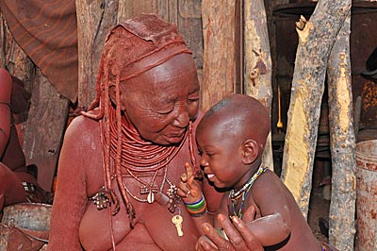
How did we manage for millennia?

Slide 13
Vitamin D and infant formula milk
Formula milk is modified from cow’s milk
Modifications are made to more closely mimic observed properties of breast milk
Vitamin D began to be added to combat higher incidence of rickets in formula-fed infants observed in early 20th century

Slide 14
Vitamin D and infant formula milk
Batches or individual cans of formula may contain variations of amount of ingredients / Vitamin D stated on the label
Studies find formula-fed infants with rickets/vitamin D deficiency – level in formula is ‘maintenance dose’
Formula milk companies are running education events on the topic of vitamin D

Slide 15
What should we tell women?
Universal information about vitamin D
  Targeted information about eligibility for Healthy Start
Supplement in pregnancy (ideally before!)
Take / give baby supplements to address sunlight deficiency
Inform about foods that can help with vitamin D requirements

Slide 16
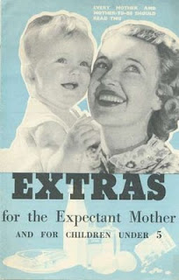

We’ve done it before...

Slide 17
What are the barriers to giving these messages?

Slide 18
Barriers...
Staff unsure about universal message
Lack of time to give public health messages
Lack of general awareness in society
Eligibility for Healthy Start doesn’t match highest risk groups
Issues with Healthy Start administration / access / availability

Slide 19
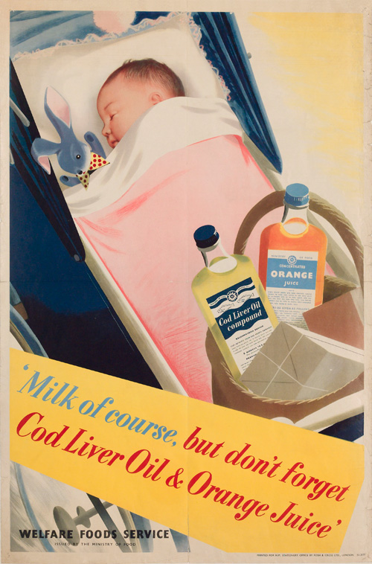
thank you

